Slide 1
Project 2: Motion Detection via Communication Signals

Slide 2
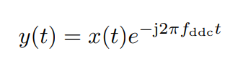
Intro.1:Time Domain Processing of Signal
Digital Downconversion(DDC):
Low-Pass Filter(LPF)

Slide 3
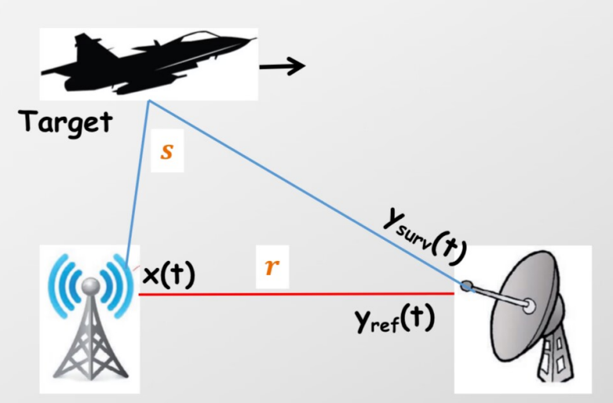
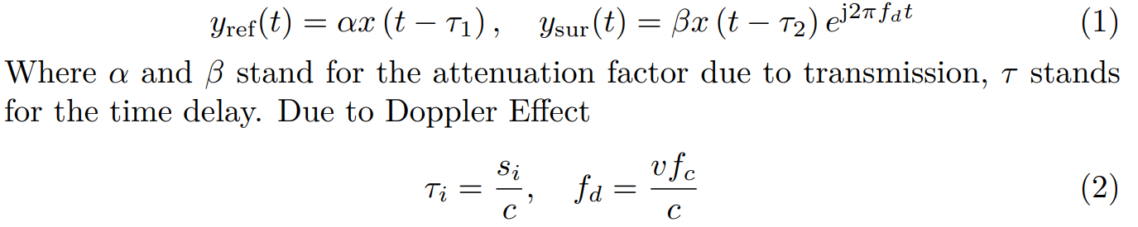
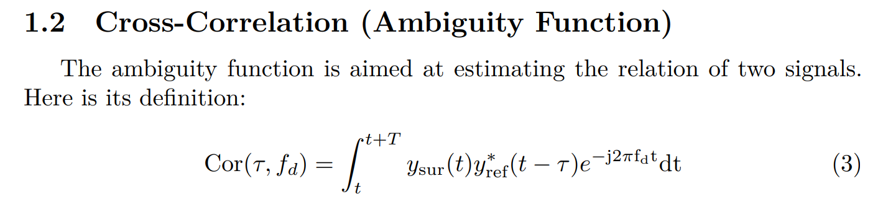
Intro. 2: Principles of Motion Detection

Slide 4
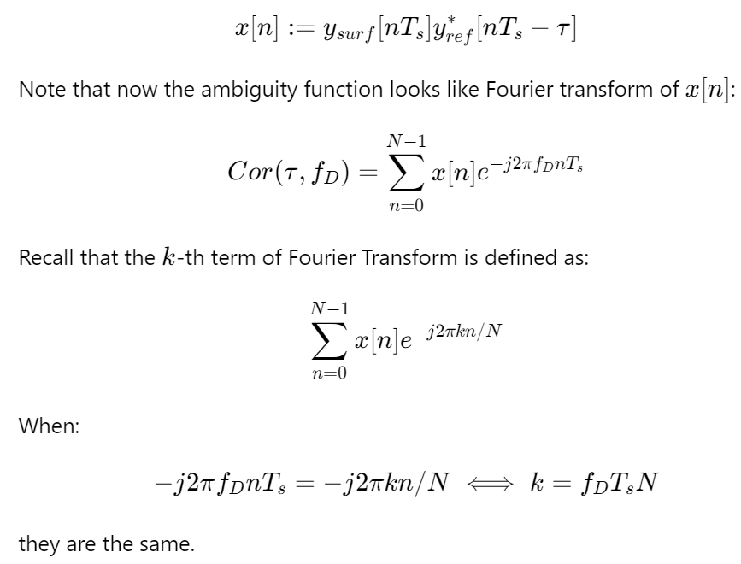
Ext. 2: Optimization of Algorithm

Slide 5
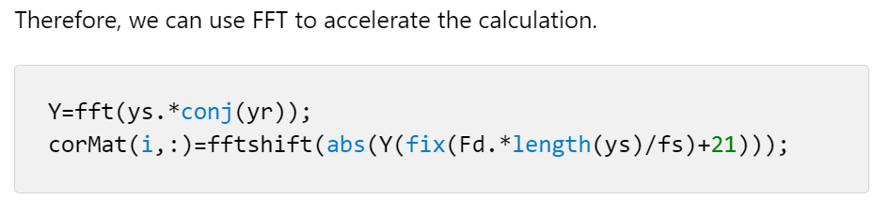
Ext. 2: Optimization of Algorithm

Slide 6
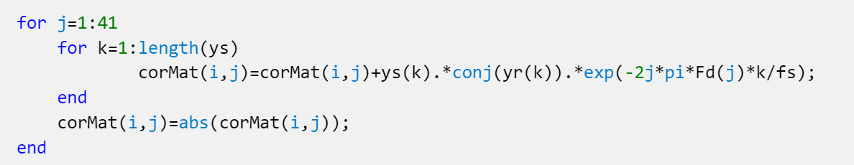
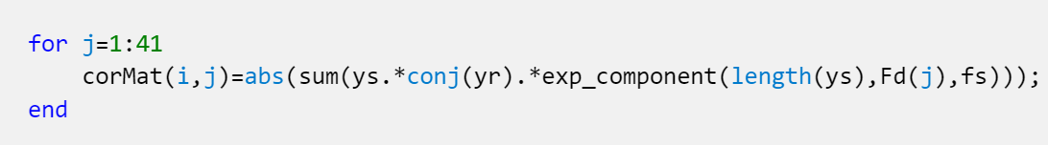

Ext. 2: Optimization of Algorithm
`for` Loop
Matrix Operations (`.*`, sum())
FFT

Slide 7
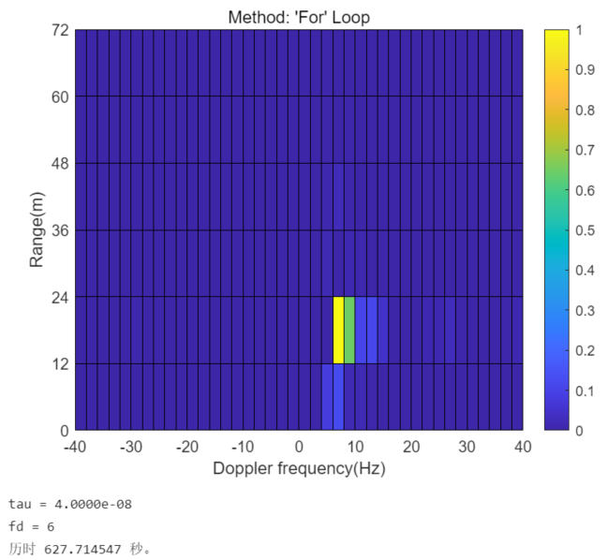
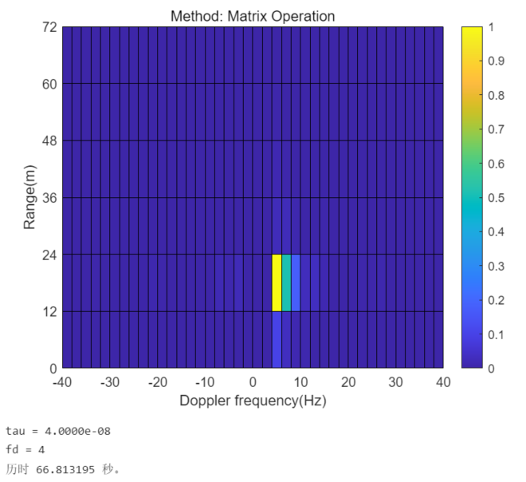
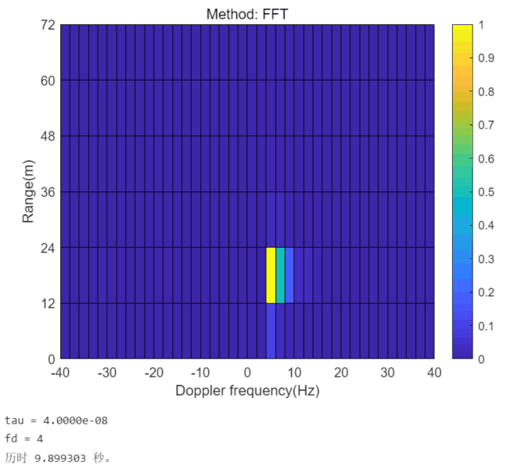
Ext. 2: Optimization of Algorithm
Method | Time
`for` Loop | 627.7s
Matrix Operation | 66.8s
FFT | 9.90s

Slide 8
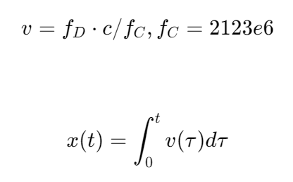
Ext. 3: Recover the Object’s Movement

Slide 9
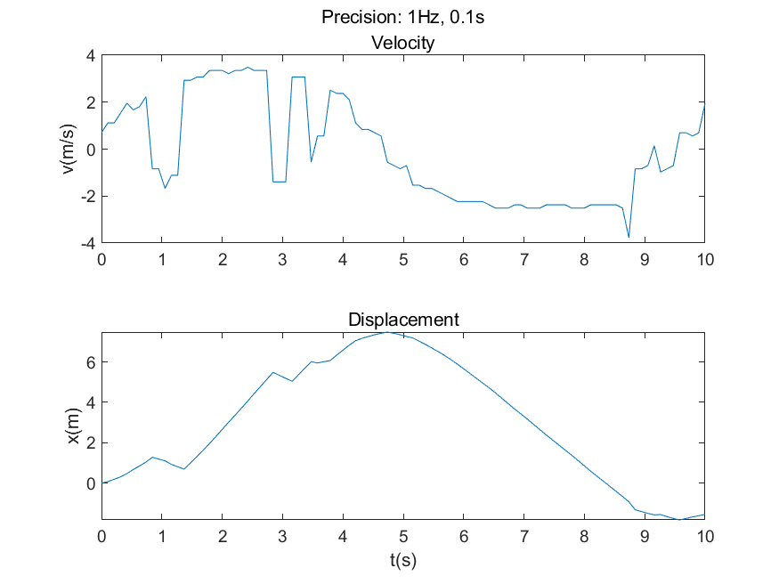
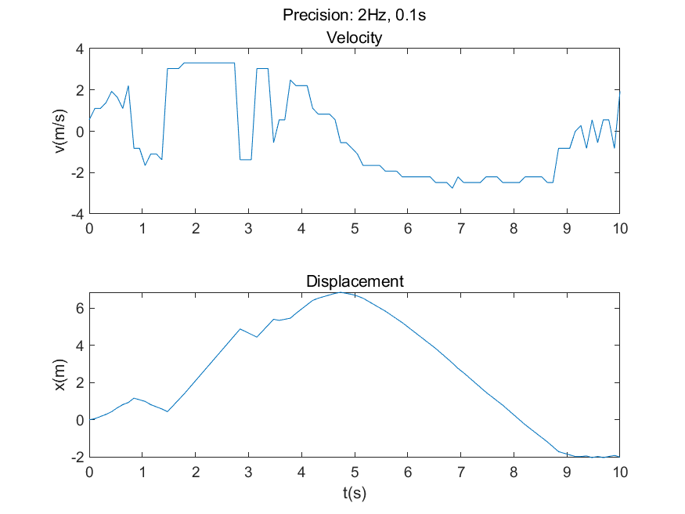
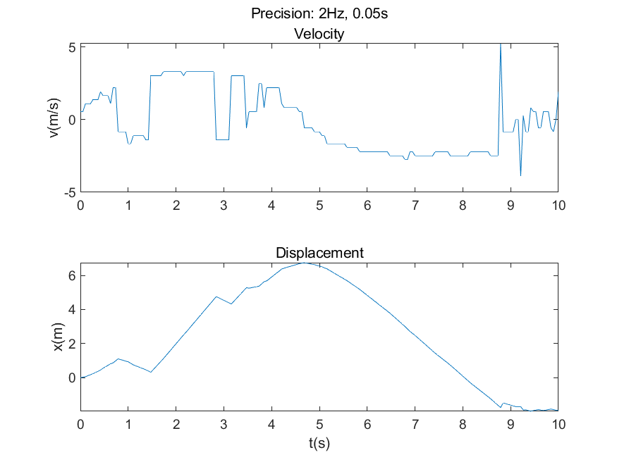
Ext. 3: Recover the Object’s Movement

Slide 10
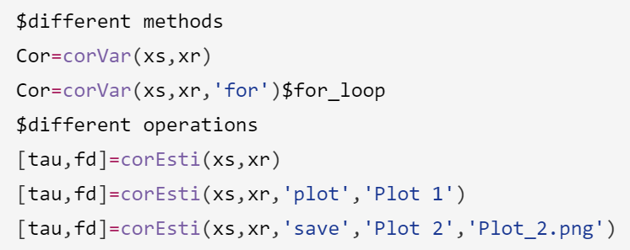
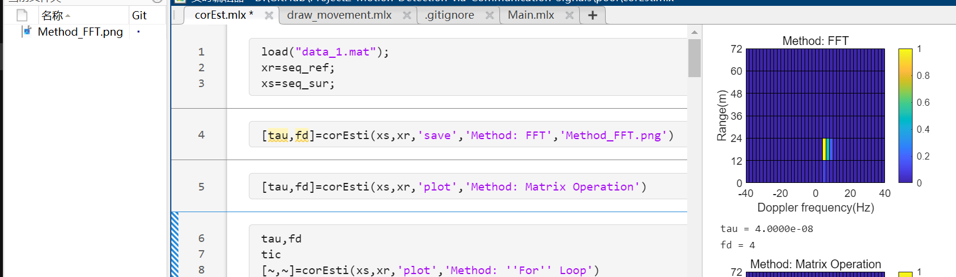
Ext. 4: Coding Habits—Encapsulation, varargin

Slide 11
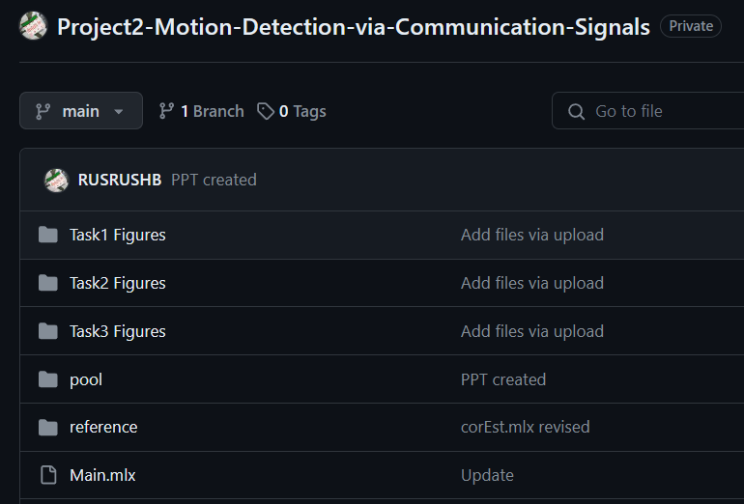
Ext 4: Coding Habits——Git

Slide 12
Conclusion
Extension 1
Extension 2: Optimization of Algorithm
Extension 3: v-t graph, x-t graph
Extension 4: Encapsulation, varargin, Git

